Slide 1


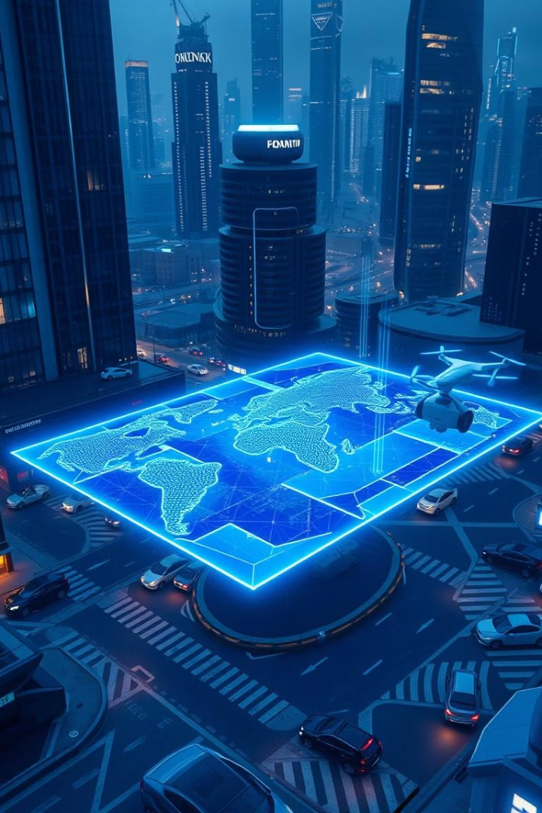
SAVEETHA SCHOOL OF ENGINEERING
SAVEETHA INSTITUTE OF MEDICAL AND TECHNICAL
SCIENCE
COURSE CODE:CSA1507
CLOUD COMPUTING FOR BIG DATA ANALYTICS
TOPIC:
Cloud-Based Smart Transportation System
Guided by, Done by,
Dr.Gnana Soundari A.venkata Rathnamma(192210089)
A.Sindhu(192211576)
Dr.Gnana soundari

Slide 2
The Problem of Traffic Congestion
Lost Time and Productivity
Increased Fuel Consumption
Stress and Frustration
Long commutes and traffic jams can cause stress, anxiety, and road rage, negatively impacting mental health.
Traffic jams waste valuable time and reduce productivity, impacting individuals and businesses.
Traffic congestion leads to higher fuel consumption and emissions, contributing to environmental problems.

Slide 3
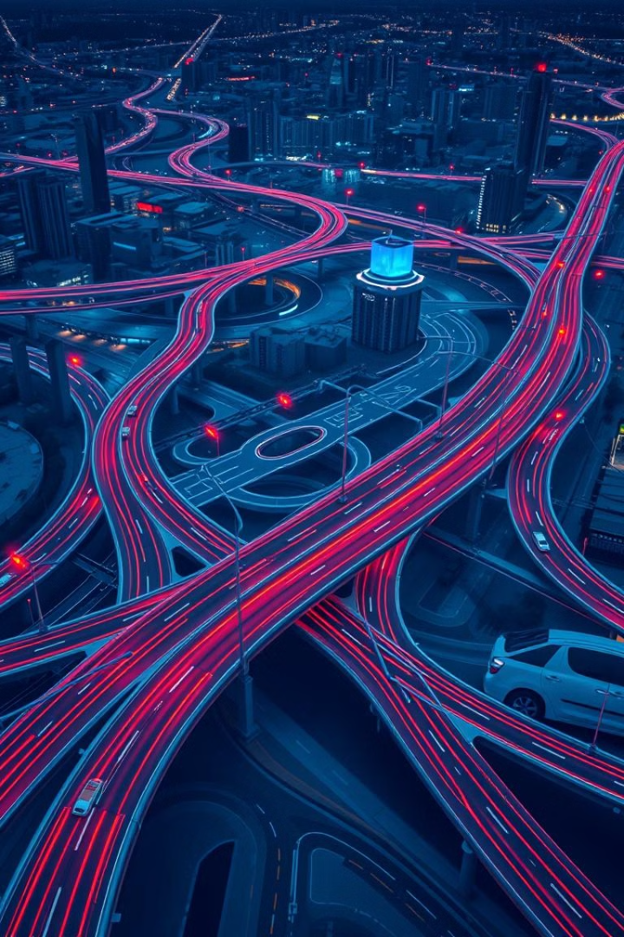
Introduction: The Need for a Smart Transportation System
1
Real-Time Traffic Monitoring
2
Data-Driven Decision Making
A smart transportation system monitors traffic conditions in real-time, providing accurate information to drivers and passengers.
Using real-time data, the system can dynamically adjust traffic flow, optimize routes, and improve overall efficiency.
3
Improved Commuter Experience
Passengers can receive real-time updates on traffic conditions, estimated arrival times, and alternative routes, improving their commutes.

Slide 4
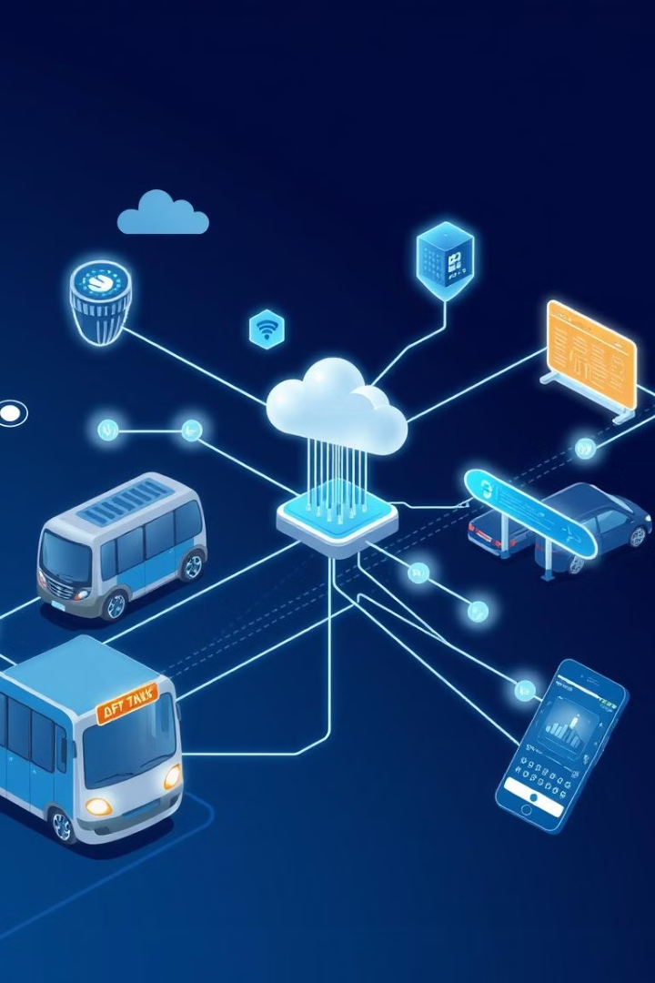
Features of the System
IoT Sensor Network
Cloud-Based Platform
A network of IoT sensors strategically placed across the city collects real-time data on traffic flow, speed, congestion, and other parameters.
The cloud platform processes and analyzes the data from sensors, enabling real-time traffic monitoring and predictive modeling.
Mobile Application
Dynamic Route Optimization
Passengers use a mobile app to access real-time traffic information, receive route guidance, and track their journey.
The system uses predictive models to analyze traffic patterns and optimize routes for public transportation, reducing congestion and improving efficiency.

Slide 5





System Design and Architecture
Data Collection
1
IoT sensors gather real-time traffic data.
Data Processing
2
Data is preprocessed and cleaned.
Data Analysis
3
Traffic patterns are analyzed.
Route Optimization
4
Predictive models suggest optimal routes.
Real-Time Updates
5
Passengers receive timely route updates.

Slide 6
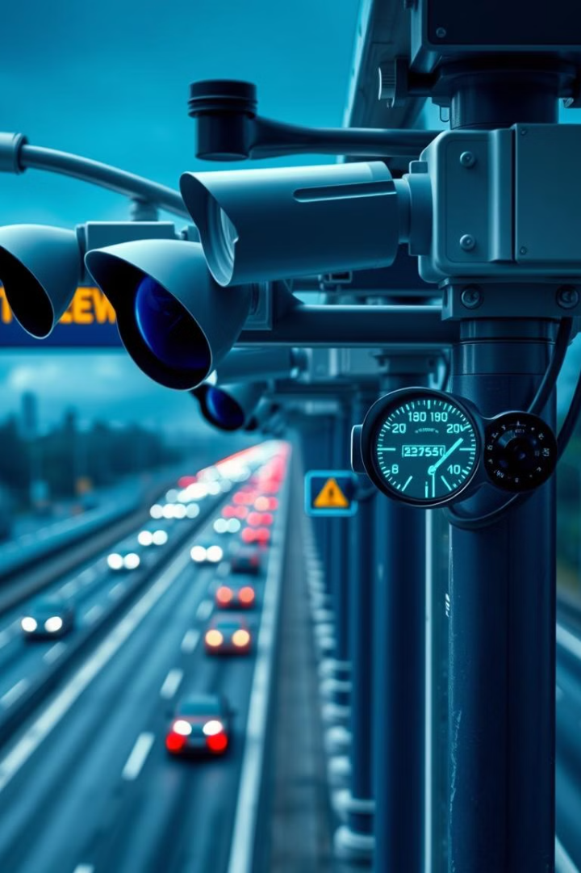




IoT Sensors and Real-Time Data Collection
Traffic Cameras
Speed Sensors
Traffic cameras capture live video footage for real-time traffic analysis.
Speed sensors monitor vehicle speed and detect potential congestion points.
GPS Tracking
Data Transmission
GPS tracking devices on public transportation vehicles provide real-time location data.
Sensors transmit data to the cloud platform via wireless networks.

Slide 7
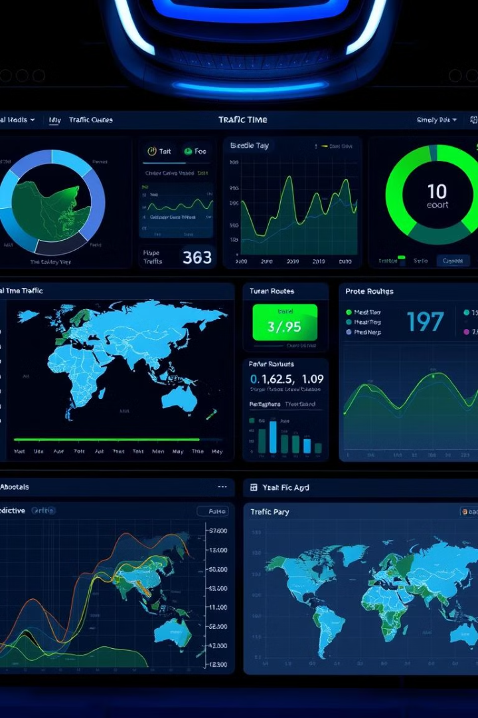
Predictive Models for Route Optimization
1
Historical Data Analysis
The system analyzes historical traffic data to identify recurring patterns and congestion points.
2
Machine Learning Algorithms
Machine learning algorithms are used to predict future traffic conditions and optimize routes in real-time.
3
Dynamic Route Adjustments
The system dynamically adjusts routes based on predicted traffic patterns and real-time data.

Slide 8
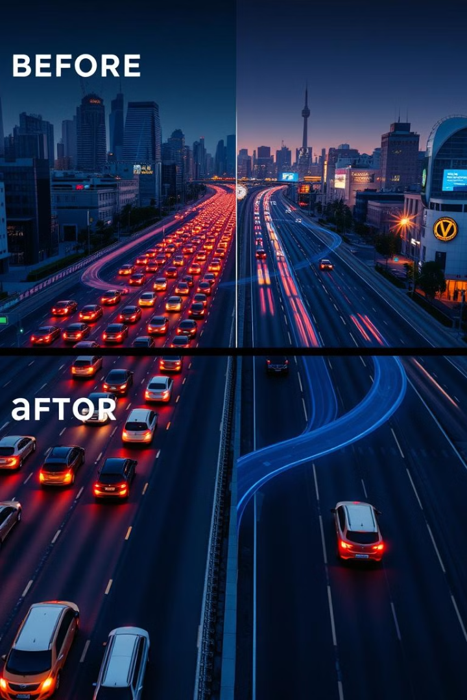
Results and Impact
10%
Reduced Congestion
The system reduces traffic congestion by 10% or more.
5%
Improved Efficiency
Public transportation efficiency increases by 5%.
15%
Faster Travel Times
Average travel times are reduced by 15%.

Slide 9
Challenges and Feature Scope
Data Privacy and Security
1
Ensuring the privacy and security of collected data is crucial.
Sensor Network Maintenance
2
Maintaining a reliable and robust sensor network requires regular maintenance and updates.
Integration with Existing Infrastructure
3
Integrating the system with existing traffic management systems can be challenging.
Public Acceptance and Adoption
4
Encouraging public acceptance and adoption of the system is essential for its success.

Slide 10

Conclusion
This innovative smart transportation system offers a powerful solution to traffic congestion, improving commutes, reducing pollution, and enhancing quality of life. By leveraging the power of IoT sensors, data analytics, and predictive modeling, we can create a more efficient and sustainable transportation future for our cities.

Slide 11


